Slide 1
Neonatal Hyperbilirubinemia
Jessie Marks DNP ARNP
Some slides adapted from Melanie Summerour MN, ARNP

Slide 2
Objectives
Identify risks for jaundice; differentiate between physiologic and pathologic jaundice.
Understand the difference between direct and indirect hyperbilirubinemia
Understand how to use BiliTool

Slide 3
Physiology Review
Bilirubin production — Bilirubin is a product of heme catabolism, which occurs primarily in the spleen and liver.
Hepatic uptake – Circulating bilirubin, which is bound to albumin, is transported to the liver. Bilirubin dissociates from albumin and is taken up by hepatocytes, where it is processed for excretion.
Conjugation – In hepatocytes, enzymes change the bilirubin to be more water-soluble
Biliary excretion – Excreted in bile. In infant's the conjugated bilirubin can be unconjugated due to little gut bacteria. Unconjugated bilirubin can be reabsorbed through intestinal wall.

Slide 4
Types of Hyperbilirubinemia
Indirect (unconjugated) hyperbilirubinemia
Not yet processed by liver
Physiologic
Breastmilk jaundice
Prolonged neonatal hyperbilirubinemia
Direct (conjugated) bilirubin
Bilirubin after processing by liver
Infection
Metabolic disorders
Biliary obstruction
Notes:
Physiologic
Normal process in first days after birth
Due to normal physiologic adaptations
Pathologic
Due to pathologic factors that alter normal bilirubin metabolism

Slide 5
Causes of Unconjugated Hyperbilirubinemia
Bilirubin overproduction
Hemolytic causes
Immune mediated
Nonimmune mediated
Sepsis
Non-hemolytic causes
Impaired hepatic bilirubin uptake
Impaired hepatic bilirubin conjugation

Slide 6
Causes of Conjugated Hyperbilirubinemia
Extrahepatic obstruction
Infection
Disorders of carbohydrate metabolism
Disorders of amino acid metabolism
Disorders of lipid metabolism
Disorders of bile acid synthesis
Inherited cholestatic disorders

Slide 7
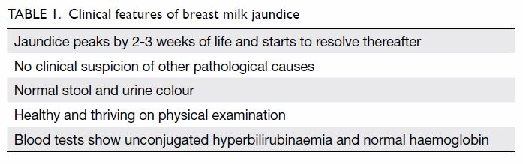
Breast Milk Jaundice
Management of Hyperbilirubinemia in the Newborn Infant 35 or More Weeks of Gestation. Pediatrics Jul 2004, 114 (1) 297-316; DOI: 10.1542/peds.114.1.297
Notes:
reference

Slide 8
Risk Factors for Hyperbilirubinemia
Predischarge TSB or TcB close to phototherapy threshold
Lower gestational age
Exclusive breastfeeding with suboptimal intake
Jaundice in first 24 hours
Hemolysis from any cause
Previous parent/sibling requiring phototherapy or exchange transfusion
Phototherapy before discharge
Cephalohematoma or significant bruising
Down syndrome
Macrosomic infant of diabetic mother

Slide 9
Neurotoxicity Risk Factors
- Isoimmune Hemolytic Disease - G6PD deficiency
- Other hemolytic conditions - Gestational age < 38 weeks - Significant clinical instability in previous 24 hours - Sepsis or clinical suspicion for sepsis - Albumin < 3.0 g/dL

Slide 10
Hemolytic Disease of the Newborn
Rh incompatibility
Rh- mother gives birth to Rh+ infant
If any mixing of maternal and fetal blood occur, maternal anti-Rh antibodies will attack infant's Rh+ red blood cells, causing breakdown.
ABO incompatibility:
Anti-A or Anti-B antibodies are present in mother with blood type O and are transferred to newborn of A, B or AB blood group
If mixing of maternal and fetal blood occurs during pregnancy or the birth process, these antibodies can also attack the baby’s red blood cells and cause hemolysis.
In general, ABO reaction is less serious than Rh incompatibility (which can be fatal if severe and untreated), and usually only results in jaundice and mild anemia.
Notes:
Alloimmune HDFN primarily involves the major blood groups of Rhesus (Rh), A, B, AB, and O, although minor blood group incompatibilities (Kell, Duffy, MNS, P, and Diego systems) can also result in significant disease/ Only maternal immunoglobulin G (IgG) causes HDFN.

Slide 11
Key Points to AAP Guidelines
Promote breastfeeding
Nursery protocols for identifying jaundice
Measure total serum bilirubin or transcutaneous bilirubin on all infants jaundiced in first 24 hours of life
Visual estimation of jaundice can lead to errors
Interpret bilirubin levels according to infant age in hours
Higher the risk the younger the gestational age
Perform risk assessment on all infants prior to discharge
Give parents written and oral information on jaundice
Provide follow up based on time of discharge and risk assessment
Treat newborns with phototherapy when indicated
Management of Hyperbilirubinemia in the Newborn Infant 35 or More Weeks of Gestation. Pediatrics Jul 2004, 114 (1) 297-316; DOI: 10.1542/peds.114.1.297

Slide 12
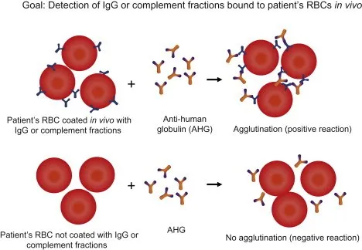
Labs
Serum Bilirubin
Indirect
Direct
Direct Coombs Test:
Looking for foreign antibodies in newborn blood that are attached to the RBCs.
Indirect Coombs Test:
maternal antibody screen that identifies antigens.
Ask lab to identify which antibodies are present

Slide 13
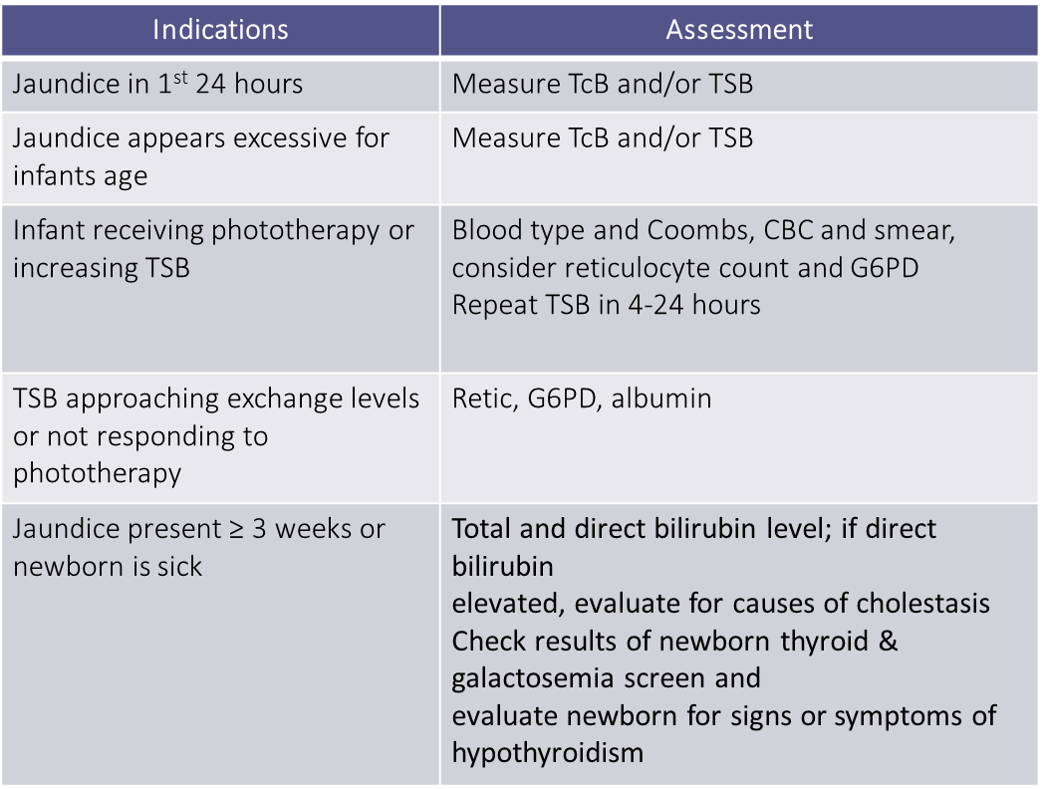
Laboratory Recommendations

Slide 14
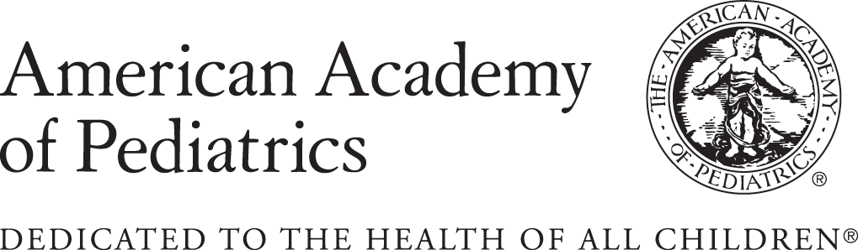
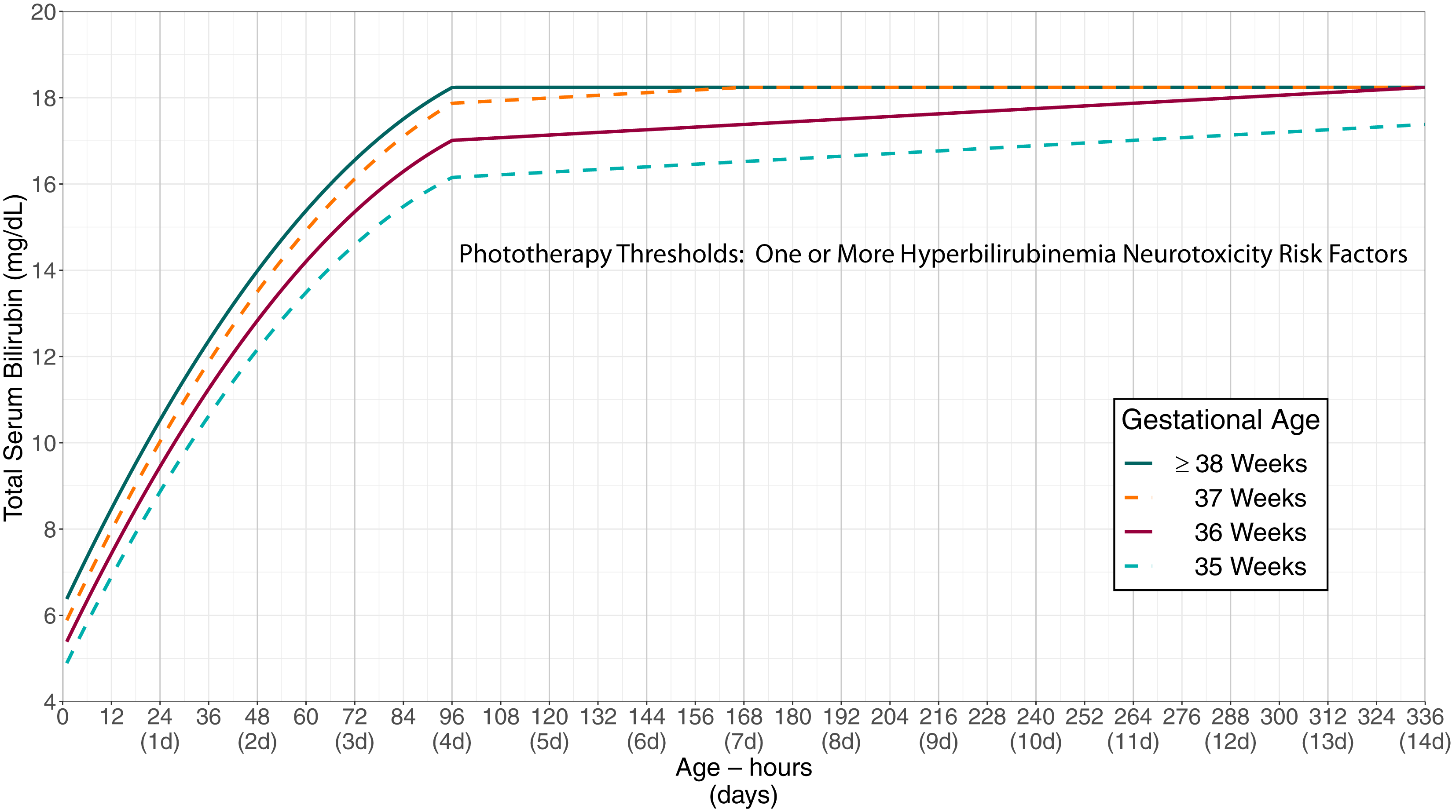
From: Clinical Practice Guideline Revision: Management of Hyperbilirubinemia in the Newborn Infant 35 or More Weeks of Gestation
Pediatrics. 2022;150(3). doi:10.1542/peds.2022-058859
Figure Legend:
Phototherapy thresholds by gestational age and age in hours for infants with any recognized hyperbilirubinemia neurotoxicity risk factors other than gestational age. These thresholds are based on expert opinion rather than strong evidence on when the potential benefits of phototherapy exceed its potential harms. Use total serum bilirubin concentrations; do not subtract the direct-reacting or conjugated bilirubin from the total serum bilirubin. In rare cases of severe hyperbilirubinemia in which the direct-reacting or conjugated bilirubin exceeds 50% of the TSB, consult an expert. Hyperbilirubinemia neurotoxicity risk factors include gestational age <38 weeks; albumin <3.0 g/dL; isoimmune hemolytic disease, glucose-6-phosphate dehydrogenase (G6PD) deficiency, or other hemolytic conditions; sepsis; or any significant clinical instability in the previous 24 hours. See Supplemental Fig 2.
Date of Download: 4/3/2023
Copyright © 2023 American Academy of Pediatrics. All rights reserved.

Slide 15
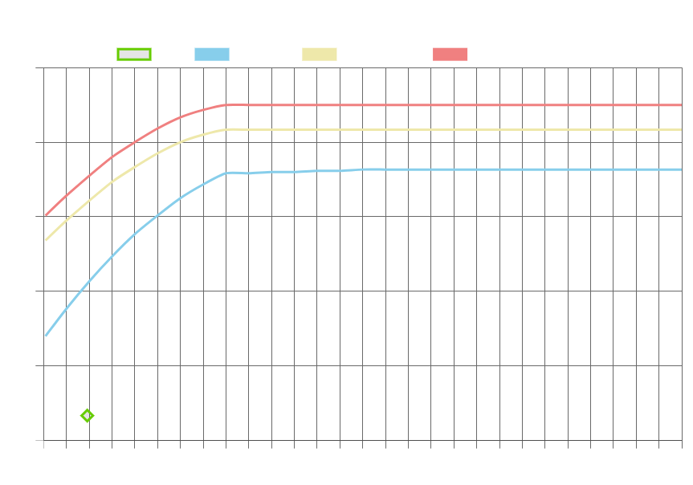
Management of Hyperbilirubinemia in the Newborn Infant 35 or More Weeks of Gestation. Pediatrics Jul 2004, 114 (1) 297-316; DOI: 10.1542/peds.114.1.297

Slide 16
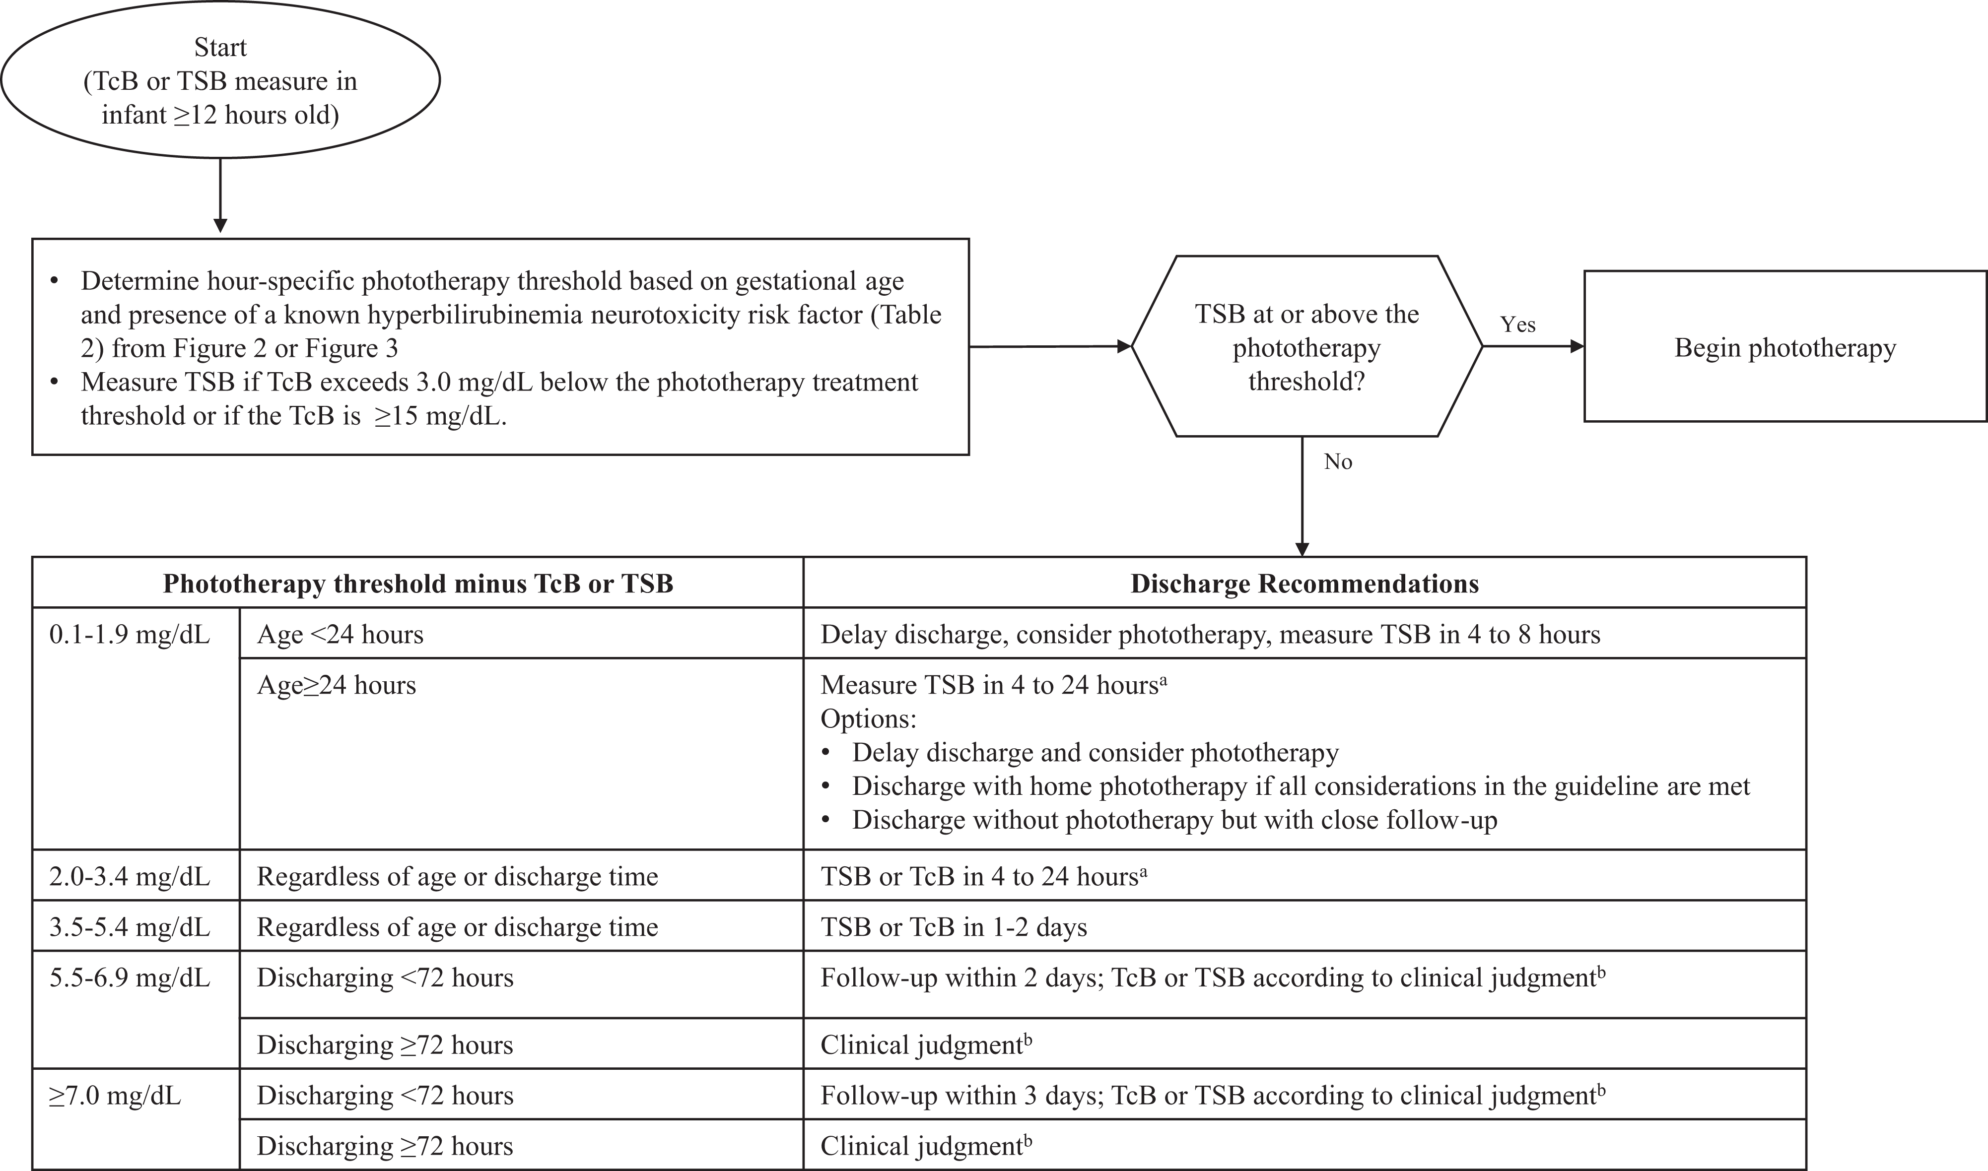
From: Clinical Practice Guideline Revision: Management of Hyperbilirubinemia in the Newborn Infant 35 or More Weeks of Gestation
Pediatrics. 2022;150(3). doi:10.1542/peds.2022-058859
Figure Legend:
Flow diagram for infants during the birth hospitalization to determine postdischarge follow-up for infants who have not received phototherapy. ªUse clinical judgment and shared decision making to determine when to repeat the bilirubin measure within this 4 to 24 hour time window. ^{b}Clinical judgment decisions should include physical examination, the presence of risk factors for the development of hyperbilirubinemia (Table 1) or hyperbilirubinemia neurotoxicity risk factors (Table 2), feeding adequacy, weight trajectory, and family support.
Date of Download: 4/3/2023
Copyright © 2023 American Academy of Pediatrics. All rights reserved.

Slide 17
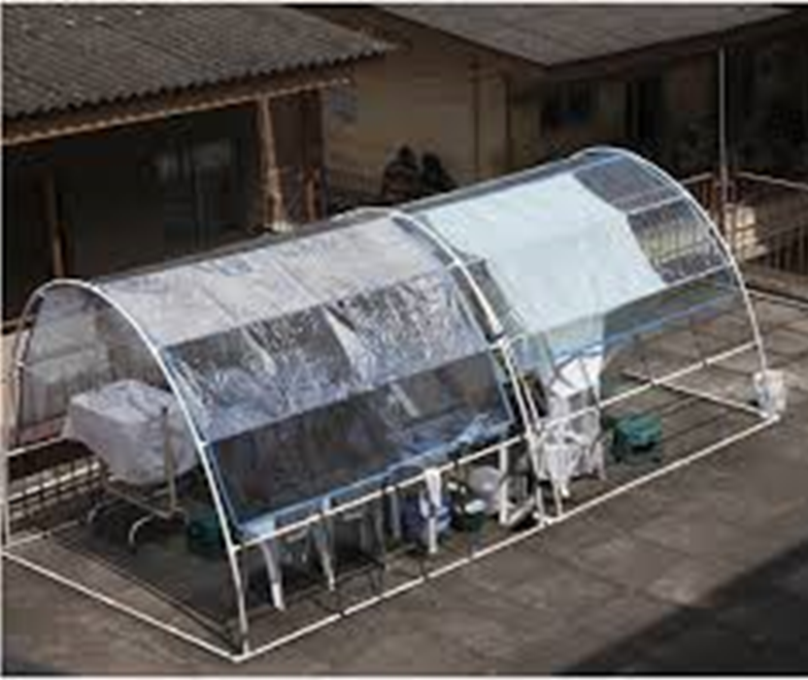
Sunlight Exposure
Direct sunlight — Can lower bilirubin levels, direct sunlight is NOT recommended due to risk of sunburn and UV radiation.
Filtered sunlight — Filtered sunlight has been suggested as a clinical alternative in low-resource settings when regulated and approved phototherapy devices are not available. Commercially available window tinting films have been developed that selectively allows the transmission of blue light and removes UV and infrared light rays.

Slide 18
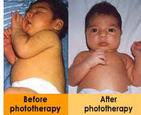
Rebound Jaundice
Rebound hyperbilirubinemia
Increase in total bilirubin following phototherapy and total bilirubin is usually lower than the start of phototherapy.
Usually does not require restarting phototherapy, however, significant rebound hyperbilirubinemia can reach phototherapy thresholds within 72 hours of initial treatment termination. Degree of rebound is based on risk factors.
No specific guidelines
Prediction rule for rebound hyperbilirubinemia study
In the study they stopped phototherapy at 2 mg/dl below starting threshold
Findings showed a rebound probability of 2.5% for infants >38 weeks and 10.2% for infants <38 weeks

Slide 19
Case Study
A 38w1d newborn, now at 29 hours of life born via cesarean for arrest of descent after a long induction for preeclampsia. She had meconium-stained fluid. No maternal infection. Her Apgar's were 7 and 9. No other resuscitation except stimulation was needed.
She weighed 3400 gm at birth. She has significant caput succedaneum.
She is breastfeeding well. Her weight loss is 1% at 24 hours. She appears jaundiced to the nipples. Her blood type is O as is her mom's. Direct coombs negative. Her sister required phototherapy.
At 24 hours her bilirubin level was 9.1 mg/dl.
Does she have any hyperbilirubinemia risk factors? If so which ones?
What is the next step in management?

Slide 20
Case Study Continued
You repeat a TSB in 4 hours. Her repeat bilirubin at 28 hours is 12.9 mg/dl.
What is the next step?
CBC and Retic show no evidence of hemolytic disease. The infant's repeat bilirubin at 34 hours of age was 12.6 mg/dl. You repeat another level at 58 hours of age and it was 11.7. When would you discontinue phototherapy and would you do a rebound?
Notes:
Consider rebound bilirubin when phototherapy is discontinued

Slide 21
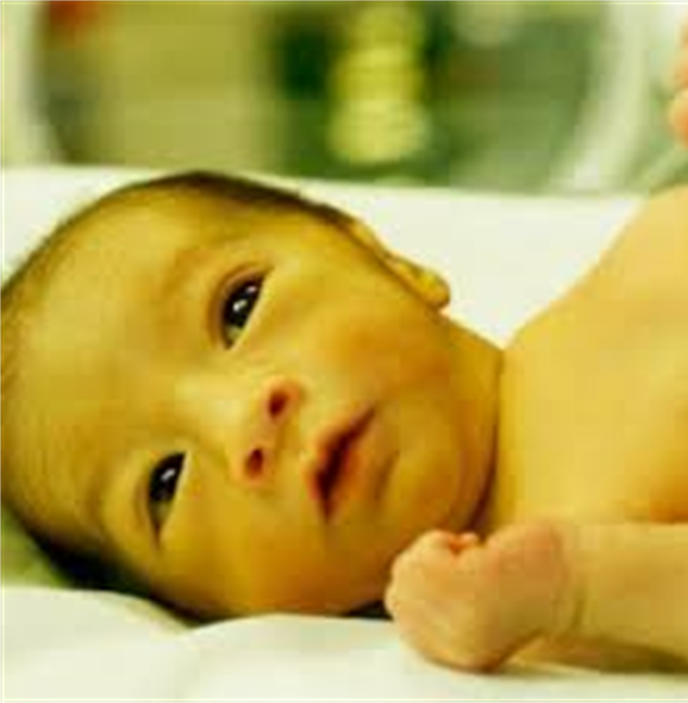
Case Study 2
A mother calls you into the room of a 39w3d infant due to concerns of jaundice. Infant is 14 hours old. There was no concerns for infection at birth and no resuscitation was needed. Mother is A positive, there is no ABO incompatibility. No abnormal prenatal ultrasounds. On exam infant has icterus tones to upper chest.
You decide to draw a TSB and it is 18 mg/dl.
What is your next step in management?
Notes:
Transfer to NICU for escalation of care

Slide 22
Case Study 3
A 37w2d male infant born via vaginal delivery to a G1P1 mother. Unremarkable pregnancy and delivery. Apgars 8, 9. Birthweight was AGA. Mother and infant O positive, direct coombs negative.
At 24 hours total bilirubin was 7.8 mg/dl. Indirect bilirubin was 5.5 mg/dl and direct bilirubin was 2.3 mg/dl.
How would you interpret these labs?
What would you do next?
Notes:
How would you interpret this and what would you do next?

Slide 23
Conjugated Hyperbilirubinemia
Serum conjugated bilirubin concentration greater than 1.0 mg/dL if the total bilirubin is <5.0 mg/dL
Or greater than 20 percent of the total bilirubin if the total bilirubin is >5.0 mg/dL
Likely from impairment in the excretion of bile (Cholestasis)
Defects in Intrahepatic production
Transport of bile
Mechanical obstruction of bile flow
In term infants, the most common causes of neonatal cholestasis are biliary atresia (25 to 40 percent) and an array of rare genetic disorders (25 percent collectively)
Identifying biliary atresia before 60 days of life has improved outcomes.

Slide 24
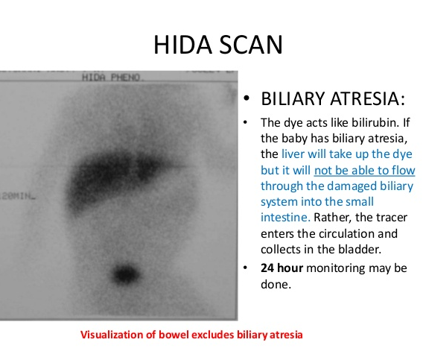
Case Study 3
To aid in diagnosis of elevated conjugated bilirubin
CBC, CMP and PT/PTT
Abdominal Ultrasound and Hepatobiliary scintigraphy (Hida Scan)
Consult with GI
Possibly start ursodiol or other medication.
Notes:
Reference

Slide 25
Case Study 4
An infant presents to clinic for their 2 week well child visit. Infant was born at 40w1d and had 8,9 Apgars. Mother was O positive and infant was O positive, coombs negative. Normal hospital course. Infant is exclusively breastfeeding. At time of discharge infant's bilirubin was 5.8 mg/dl. Repeat bilirubin on 3 days of life was 7.8 mg/dl. Infant has regained birthweight.
Mother states that infant looks more yellow than previously.
On exam infant appears to be jaundice to the nipple line. You decide to draw a TSB. The level comes back at 17 mg/d.
How would you interpret this? What would be your next step in management?

Slide 26
Case Study 4 continued
Take detailed feeding and output history
You decide to repeat TSB in 24 hours.
Repeat total bilirubin was 18 mg/dl.
What would you do next?
Safe to allow infant to breastfeed with close monitoring
Consider 2-3 days of formula only and repeat level
If it continues to rise phototherapy
Notes:
Safe to allow infant's to breastfeed with close monitoring, may need to consider a few days of formula.

Slide 27
References
Management of Hyperbilirubinemia in the Newborn Infant 35 or More Weeks of Gestation. Pediatrics Jul 2004, 114 (1) 297-316; DOI: 10.1542/peds.114.1.297
Hyperbilirubinemia in the Newborn Infant ≥35 Weeks’ Gestation: An Update With Clarifications. M. Jeffrey Maisels, Vinod K. Bhutani, Debra Bogen, Thomas B. Newman, Ann R. Stark, Jon F. Watchko. Pediatrics Oct 2009, 124 (4) 1193-1198; DOI: 10.1542/peds.2009-0329
Safety and Efficacy of Filtered Sunlight in Treatment of Jaundice in African Neonates. Tina M. Slusher, Hendrik J. Vreman, Bolajoko O. Olusanya, Ronald J. Wong, Ann M. Brearley, Yvonne E. Vaucher and David K. Stevenson. Pediatrics 2014;133;e1568. DOI: 10.1542/peds.2013-3500
Postnatal diagnosis and management of hemolytic disease of the fetus and newborn. Calhoun, Darlene A. (2018) Uptodate. Retrieved January, 31, 2019.
Approach to evaluation of cholestasis in neonates and young infants. Loomes, Kathleen M and Erlichman, Jessi. (2021). Uptodate. Retrieved March 2021.
A Simpler Prediction Rule for Rebound Hyperbilirubinemia. Chang, P W and Newman, T B. Pediatrics (2019). 144; DOI: 10.1542/peds.2018-3712
Current Diagnosis and Treatment Pediatrics. Hay, W. W., Levin, M. J, Abzug, M. J. and Bunik, M. (2020), pgs 20-22.

